Slide 1
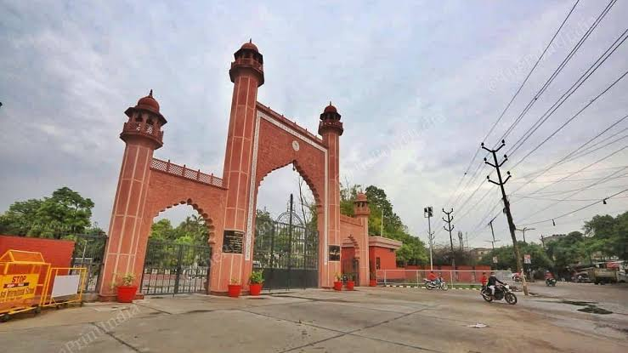
IMAGE IN PPT
PPT ABOUT NOTHING

Slide 2
TABLE, CHART AND TRANSITION
HUH | FTYU | HJJN | XRDC | NVM
665 | 545 | 564 | 579845 | 4875

Slide 3


AINMATION, SOUND
HGFJ
FYUGIH
FUYBIK
GUGGBIN
UBIHNLKM

Slide 4


BACKGROUND TEMPLATE

Slide 5
HEADER
www.PPT5.comSLIDE_5 Presentation.pptx
WWW.Quora.ComSeasonal Greeting.pptx
WWW.CURAJ.AC.INIt_Fest.pptx

Slide 6
Graph In PPT
shjgsjh | fgjkvh | iguiltf | huijgbo | jity | ywaeo | Xzbh
54 | 55 | 20 | 17 | 25 | 36 | 45
65 | 27 | 35 | 29 | 16 | 42 | 39

